Slide 1
The Emergence of the Nation State System
IB Global Politics

Slide 2
Many actors are players in the drama of world politics
The most fundamental actors are individual people
Every day, the behavior of individuals affects how trends in the world will unfold (choosing to recycle; parent a child; migrate to another country)
But individuals exert even more influence through organizations

Slide 3
‘Human beings are political animals’ - Aristotle
They join groups to enhance their security and welfare

Slide 4
Throughout world history, people have belonged to many types of political organization inc. bands, tribes, chiefdoms and states
When organizations come into contact they sometimes collaborate for mutual benefit. More often, they compete over scarce resources

Slide 5
Nation States are the pre-eminent political organisations on the world stage today.
This has not always been the case
When do you think they achieved their pre-eminent position. What was the reason for this? (Discuss briefly in groups and feedback to class)

Slide 6
Modern Nation State System born with Peace of Westphalia (1648)
Peace of Westpahila ended Thirty Years War
Thirty Years War – complex, multidimensional conflict originating from cultural, political and economic currents sweeping Europe following Protestant Reformation

Slide 7
Dimension of Thirty Years War
Religious – clashes between Protestants and Catholics
Governmental – civil war over issue of imperial authority within Holy Roman Empire (territory stretching from France to Poland, united through marriages to Catholic Hapsburg dynasty)
Geostrategic – Austrian and Spanish branches of House of Hapsburg against Danish, Swedish, Dutch and French thrones

Slide 8
What started it?
Prague, May 21, 1618 – members of local assembly denounced anti-protestant policies of Hapsburgs and threw two Hapsburg emissaries from a window in Hradčany Castle into a dung heap below
I'm so sorry about his voice

Slide 9
Hapsburgs responded with force…
Igniting a war that drew in participants from across Europe – producing tragedy of epic proportions
Aftermath – much of central Europe lay desolate, stripped of population, drained of population by massacre, famine and disease

Slide 10
How does this relate to the emergence of the nation state?
Prior to the reformation, most Europeans lived in a galaxy of fiefdoms and principalities, but considered themselves belonging to a larger Christian commonwealth led by the Pope
Following Thirty Years War, this mediaeval vertical order was replaced by a horizontal system of autonomous states that recognized no higher authority

Slide 11
Terms of Peace of Westphalia (1848)
All states possessed same legal rights:
  Sole jurisdiction over their territory
  Unrestricted control over domestic affairs
  Freedom to engage in foreign relations with other powers
  Hilarity

Slide 12
Concept of Sovereignty embodied exclusive rights of states to make, enforce and adjudicate laws within their territory
No overarching institution had the authority to regulate state conduct
Anarchy became core organizing principle of Westphalia rather than Hierarchy

Slide 13

Website Doc

Slide 14
Peace of Westphalia provides terminology to describe nation states
State, nation and nation-state are all slightly different concepts. Discuss what you think the differences between them are

Slide 15
State
An organised political entity with a permanent population, a well defined territory and a government

Slide 16
Nation
A group of people who feel a common identity due to a shared language, culture and history

Slide 17
Nation-State
A specific geographic area containing a sovereign polity whose population identifies with that polity

Slide 18
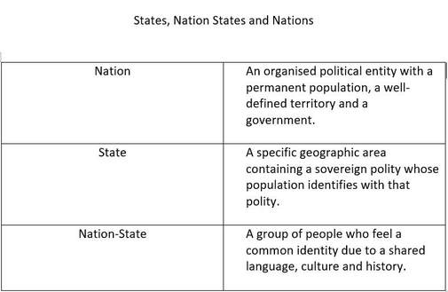
Match definitions with each of the following and why
Singapore
Catalonia
USA
Bangladesh
Norway
Kashmir
Xhosa Tribe
Tibet

Slide 19
Some examples and words of caution…
Some states (Iceland, Japan) are ethnically homogenous
Some states are multination states (e.g. Nigeria’s population is composed of Igbo, Yoruba, Hausa-Fulani etc)
Some nations are multistate nations (e.g. Kurds live in Iraq, Iran and Turkey)
Any other examples that make things complicated?

