Slide 1
Foreign Aid
The Aid Debate

Slide 2
Assignment
Your task is to examine the multiple viewpoints in the aid debate and then answer the questions on the next slide. Your response can be in a format you choose that will best prepare you to answer a question about the aid debate in the exam. The only requirement is that you represent at least 3 different perspectives in your response. You can use the resources in the following or find your own. You could, for example, respond to this question in relation to the two LDC that you used before.

Slide 3
Focus Questions
To what extent do individuals and societies benefit from foreign aid?
What is a better path to development, aid or trade?
How would you design an approach to aid that encompasses multiple perspectives?

Slide 4
Cont’d
Are there certain kinds of governments that the should not receive foreign aid? If not, why not? If so, what are the characteristics of these governments and specifically why should this disqualify a country from receiving aid? If you were charged with creating a political litmus tests for aid recipients, what are the characteristics of governments who should receive aid and those that shouldn't?

Slide 5
Possible Resources
FOREIGN AID 101
GEORGE AYITTEY - A TYRANT'S BEST FRIEND
DIRECT CASH TRANSFERS-- SHOULD YOU DONATE DIFFERENTLY?
A Proven Way to Reduce Poverty: Give People More Money [Boston Globe / Evan Horowitz]

Slide 6
GHANAIAN ENTREPRENEUR: GROWTH HINDERED BY FOREIGN AID
IS AID KILLING AFRICA: DAMBISA MOYO
Farming with Friends: China is on a mission to modernize African farming—and find new markets for its own companies
BILL GATES: FOREIGN AID WORKS
https://www.gatesnotes.com/Development/Hans-Rosling-Good-News-in-Tanzania

Slide 7
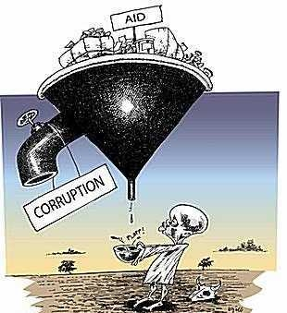

Slide 8
A Rough Guide To A Better World (read chapter 1: Development Works
CHRISTIAN AID: POVERTY OVER
Source: Poverty Over simulation
VOX: Why people die early in each country in 3 minutes
FOREIGN AID: A BLESSING OR A CURSE?
https://www.gapminder.org/videos/dont-panic-end-poverty/

