Slide 1
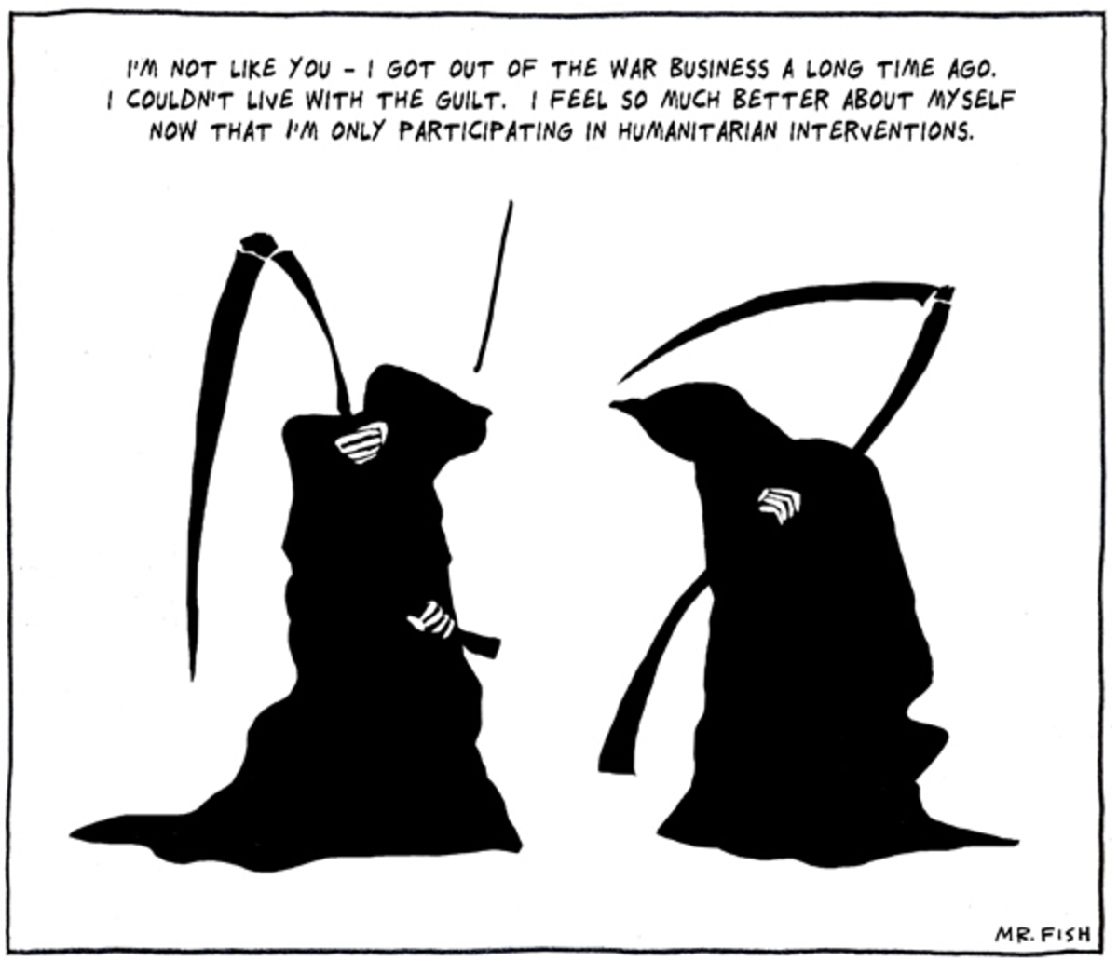

Slide 2
Peace and Conflict
Humanitarian Intervention/R2P

Slide 3
Is Violence Ever Justified?
"Some states and groups are pacifist and aim to solve conflicts without the use of violence." Name one. (Could be a social movement, too)
From Wikipedia: The Egyptian Muslim Brotherhood was legalized in 2011 and won several elections,[26] including the 2012 presidential electionwhen its candidate Mohamed Morsi became Egypt's first elected president after the 2011 Egyptian Revolution. One year later, however, following massive demonstrations, anger at perceived discrimination and disenfranchisement against religious minorities and economic instability, Morsi was overthrown by the military and arrested. The Arab Spring brought it legalization and substantial political power at first, but as of 2013 it has suffered severe reversals.[25] The Brotherhood itself claims it is a peaceful, democratic organization,[27][28] and its leader "condemns violence and violent acts".[29] As of 2015 is considered a terrorist organization by the governments of Bahrain,[7][8] Egypt, Russia, Syria, Saudi Arabia and United Arab Emirates.[9][10][11][12]
"Some analysts, however, see the potential for non-violent Islamists to progress to violent Islamism and argue that both strongly influence each other."

Slide 4
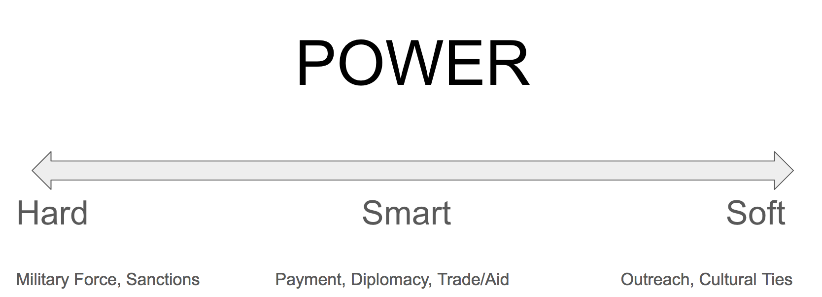
Where does Humanitarian Intervention fit on this continuum? Where does realism and liberalism fit on this continuum?

Slide 5
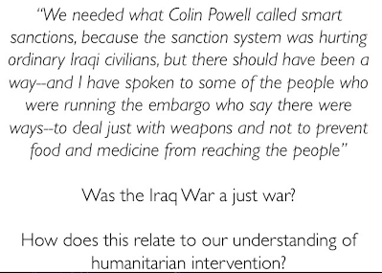

Slide 6
TODAY'S TASK: STEPS and QUESTIONS
1. Choose an example of a Humanitarian Intervention from the following:
Libya (2011)
Afghanistan (jus post bellum)
Crimea/Eastern Ukraine (2014)
Cambodia (1978)
Kosovo (1999)
Syria (2012-)
Eastern Pakistan (now Bangledesh) (1971)
South Sudan (2011)
Central African Republic (2013)
Cote d'Ivoire (2011)

Slide 7
2. Who intervened? What was the stated humanitarian mission? Win, lose or draw?
3. Read the Just War Principles in Heywood 264 (attached below)
4. Apply your chosen example to the principles. In which ways was it a just war/intervention? Justify using the specific references to the LANGUAGE of the Just War Theory (jus ad bellum) principles for military intervention :
Last Resort
Just Cause
Legit Authority
Right Intention
Reasonable Prospect of Success
Proportionality

Slide 8
5. Read the Responsibility to Protect: Principles for Military Intervention (on website, 2 pages)
6. Apply your chosen example to the R2P principles. In which ways was it an R2P intervention? Justify using the specific references to the LANGUAGE of the R2P principles for military intervention (note how these principles specify the principles of Just War Theory):
The Just Cause Threshold
The Precautionary Principles
The Right Authority
Operational Principles

Slide 9
7. Are there differences between the right to intervene (Just War Theory) and the responsibility to protect (R2P) in terms of military intervention?
8. Choose a question from one or two of the topics on the following slides to answer and justify your response.

Slide 10
State Sovereignty
Should states have unconditional sovereignty over their affairs or does the international community have the right to intervene in a country for humanitarian purposes?
Should humanitarian intervention include "regime change" when the leader is identified as causing the humanitarian crisis?

Slide 11
FOREIGN INTERVENTION
"The reality that interventions may not be plausibly mounted in every justifiable case is no reason for them not to be mounted in any case." Do you agree?
What would success look like for a humanitarian intervention? What factors might prevent that success from being achieved?
Some states have invoked R2P to justify their own unilateral actions. Are there circumstances in which unilateral measures are justified?

Slide 12
INTERNATIONAL ORGANIZATIONS
"Which of two evils is the worse: the damage to international order if the Security Council is bypassed or the damage to that order if human beings are slaughtered while the Security Council stands by"?
To what extent should international organizations be allowed to act during situations of conflict?

Slide 13
ETHNIC CONFLICT
Do the terms "ethnic conflict" and "ethnic cleansing" clarify or cloud the case for humanitarian intervention?
"It is only a matter of time before reports emerge again from somewhere of massacres, mass starvation, rape, and ethnic cleansing. And then the question will arise again in the Security Council, in political capitals, and in the media: What do we do?"

